Slide 1


NoSQL Data Management
Department of Computer Science Engineering
School of Engineering

Slide 2
Module 1 : Introduction to NoSQL and Aggregate-Oriented Data Models
Introduction to NoSQL and Aggregate-Oriented Data Models Why NoSQL? The Value of Relational Databases, Getting at Persistent Data, Concurrency, Integration, A (Mostly) Standard Model, Impedance Mismatch, Application and Integration Databases, Attack of the Clusters, The Emergence of NoSQL, Aggregate Data Models; Aggregates, Example of Relations and Aggregates, Consequences of Aggregate Orientation, Key-Value and Document Data Models, Column-Family Stores, Summarizing AggregateOriented Databases. More Details on Data Models; Relationships, Graph Databases, Schema less Databases, Materialized Views, Modelling for Data Access.

Slide 3
Session Summary
Topics
Introduction to NoSQL
Concurrency and Integration
ACID
NoSQL emergence and its main features
Learning Outcomes (LOs)
LO1: Understand the fundamental concepts of NoSQL
LO2: Describe the concepts of ACID properties.
LO3: Explain concurrency and its role in database transactions.
LO4: Describe the emergence of NoSQL and identify its primary features.

Slide 4
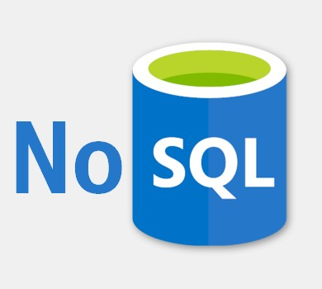
Introduction
What is NoSQL?
NoSQL is a database store that does not require table-based relational models to hold structured, unstructured, and semi-structured data.

Slide 5
Why NoSQL? And History
The concept of NoSQL databases became popular with Internet giants like Google, Facebook, Amazon, etc. who deal with huge volumes of data. The system response time becomes slow when you use RDBMS for massive volumes of data.
To resolve this problem, we could “scale up” our systems by upgrading our existing hardware. This process is expensive.
The alternative for this issue is to distribute database load on multiple hosts whenever the load increases. This method is known as “scaling out.”
NoSQL database is non-relational, so it scales out better than relational databases as they are designed with web applications in mind.

Slide 6
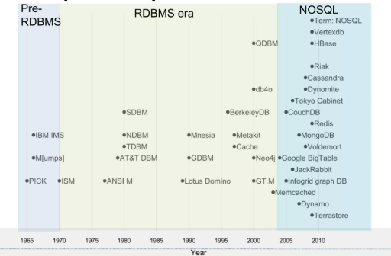
Why NoSQL? And History

Slide 7
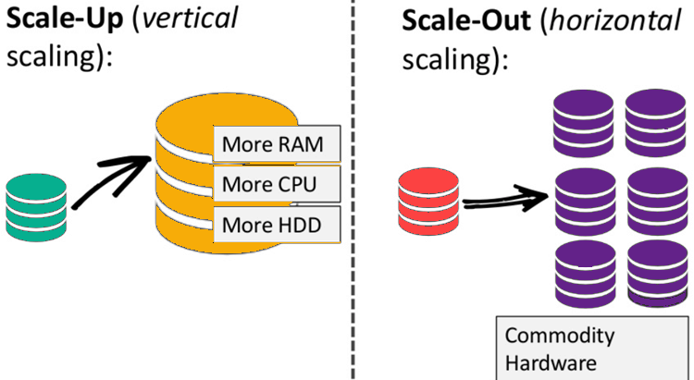
Why NoSQL? And History

Slide 8
Why NoSQL? And History
1998- Carlo Strozzi use the term NoSQL for his lightweight, open-source relational database
2000- Graph database Neo4j is launched
2004- Google BigTable is launched
2005- CouchDB is launched
2007- The research paper on Amazon Dynamo is released
2008- Facebooks open sources the Cassandra project
2009- The term NoSQL was reintroduced

Slide 9
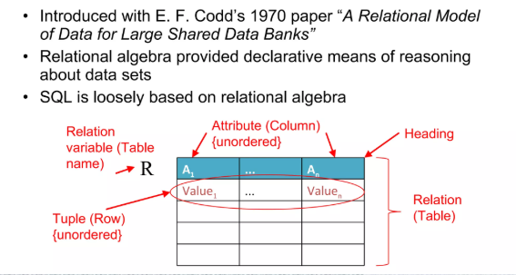
The relational model

Slide 10
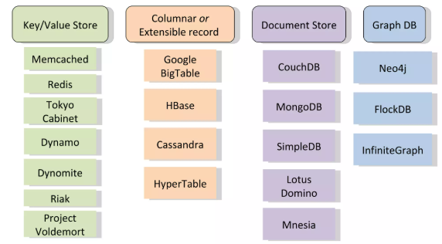
Recent NoSQL database products

Slide 11
Features of NoSQL
Non-relational
NoSQL databases never follow the relational model
Never provide tables with flat fixed-column records
Work with self-contained aggregates
Doesn’t require object-relational mapping and data normalization
No complex features like query languages, query planners, referential integrity join, ACID

Slide 12
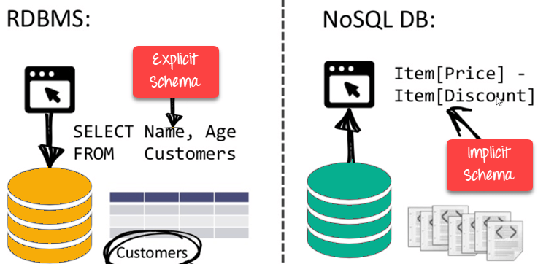
Features of NoSQL
Schema-free
NoSQL databases are either schema-free or have relaxed schemas
Do not require any sort of definition of the schema of the data
Offers heterogeneous structures of data in the same domain

Slide 13
Features of NoSQL
Simple API
Offer easy-to-use interfaces for storage and querying data provided
APIs allow low-level data manipulation and selection methods
Text-based protocol mostly used with HTTP REST with JSON
Mostly used no standard-based NoSQL query language
Web-enabled databases running as internet-facing services

Slide 14
Features of NoSQL
Distributed
Multiple NoSQL databases can be executed in a distributed fashion
Offers auto-scaling and fail-over capabilities
Often ACID concept can be sacrificed for scalability and throughput
Shared Nothing Architecture. This enables less coordination and higher distribution.

Slide 15
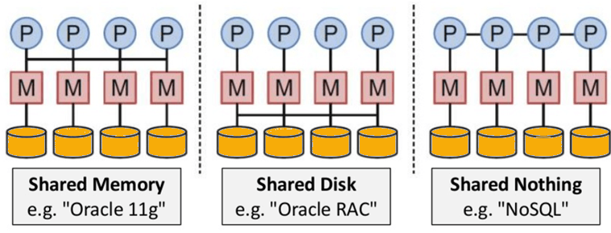
Features of NoSQL
Distributed

Slide 16
Advantages of NoSQL
Can be used as a Primary or Analytic Data Source
Big Data Capability
No Single Point of Failure
Easy Replication
No Need for Separate Caching Layer
It provides fast performance and horizontal scalability.
Can handle structured, semi-structured, and unstructured data with equal effect
Object-oriented programming which is easy to use and flexible
NoSQL databases don’t need a dedicated high-performance server

Slide 17
Advantages of NoSQL
Support Key Developer Languages and Platforms
Simple to implement than using RDBMS
It can serve as the primary data source for online applications.
Handles big data which manages data velocity, variety, volume, and complexity
Excels at distributed database and multi-data centre operations
Eliminates the need for a specific caching layer to store data
Offers a flexible schema design that can easily be altered without downtime or service disruption

Slide 18
Disadvantages of NoSQL
No standardization rules
Limited query capabilities
RDBMS databases and tools are comparatively mature
It does not offer any traditional database capabilities, like consistency when multiple transactions are performed simultaneously.
When the volume of data increases it is difficult to maintain unique values as keys become difficult
Doesn’t work as well with relational data
The learning curve is stiff for new developers
Open source options so not so popular for enterprises.

Slide 19
Summary of NoSQL
NoSQL is a non-relational DMS, that does not require a fixed schema, avoids joins, and is easy to scale
The concept of NoSQL databases became popular with Internet giants like Google, Facebook, Amazon, etc. who deal with huge volumes of data
In the year 1998- Carlo Strozzi use the term NoSQL for his lightweight, open-source relational database
NoSQL databases never follow the relational model it is either schema-free or has relaxed schemas
Four types of NoSQL Database are 1). Key-value Pair Based 2). Column-oriented Graph 3). Graphs based 4). Document-oriented

Slide 20
Summary of NoSQL
NoSQL can handle structured, semi-structured, and unstructured data with equal effect
CAP theorem consists of three words Consistency, Availability, and Partition Tolerance
The BASE stands for Basically Available, Soft state, Eventual consistency
The term “eventual consistency” means to have copies of data on multiple machines to get high availability and scalability
NoSQL offer limited query capabilities

Slide 21
Types
Types of NoSQL Databases:
Key Valued Storage
Document Storage
Column Storage
Graph Storage

Slide 22
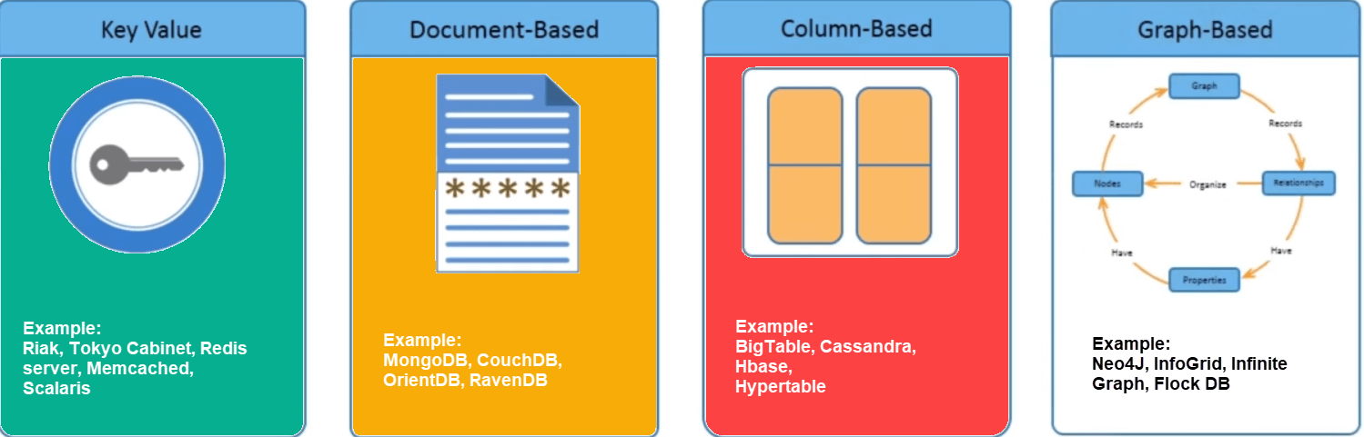
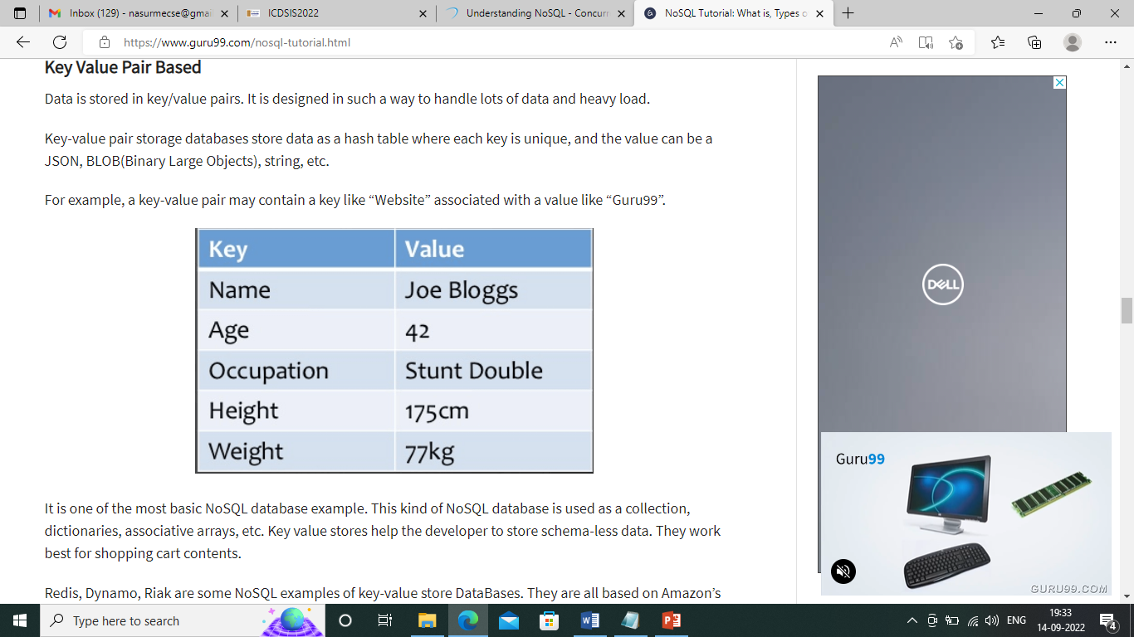
Key Value Pair Based
Data is stored in key/value pairs. It is designed in such a way to handle lots of data and heavy load.
Key-value pair storage databases store data as a hash table where each key is unique, and the value can be a JSON, BLOB(Binary Large Objects), string, etc.

Slide 23
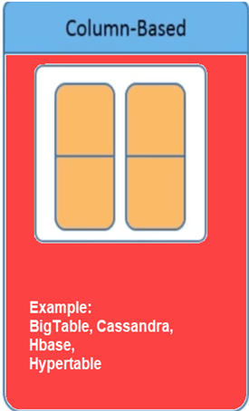
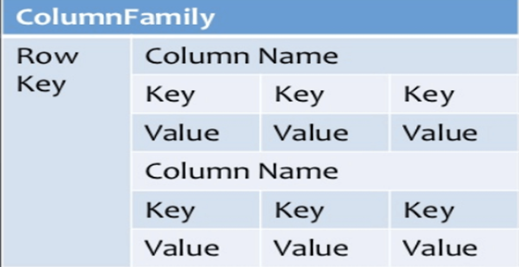
Column-based
Column-oriented databases work on columns and are based on BigTable paper by Google. Every column is treated separately. Values of single-column databases are stored contiguously.
Column-based NoSQL databases are widely used to manage data warehouses, business intelligence and Library card catalogues.

Slide 24
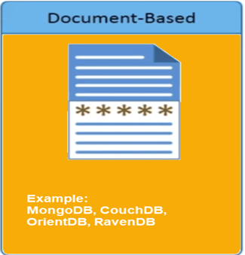
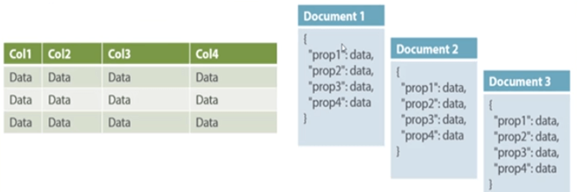
Document-Oriented:
Document-Oriented NoSQL DB stores and retrieves data as a key value pair but the value part is stored as a document. The document is stored in JSON or XML formats. The value is understood by the DB and can be queried.

Slide 25
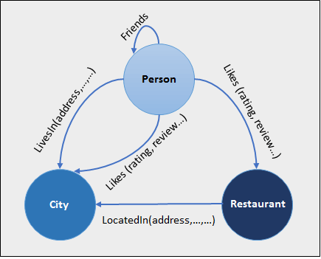
Graph Based
A graph-type database stores entities as well the relations amongst those entities. The entity is stored as a node with the relationship as edges. An edge gives a relationship between nodes. Every node and edge has a unique identifier.
Graph base database mostly used for social networks, logistics, spatial data.

Slide 26
Concurrency and Integration
Concurrency Control in Database Management System is a procedure of managing simultaneous operations without conflicting with each other. It ensures that Database transactions are performed concurrently and accurately to produce correct results without violating the data integrity of the respective Database.
Database integration is the process used to aggregate information from multiple sources—like social media, sensor data from IoT, data warehouses, customer transactions, and more—and share a current, clean version of it across an organization.

Slide 27
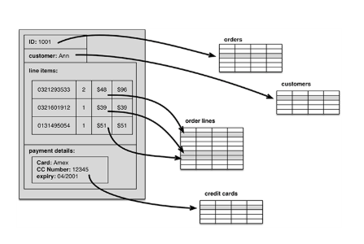
Impedance Mismatch
It is the difference between the relational model and the in-memory data structures.
In particular, the values in a relational tuple have to be simple—they cannot contain any structure, such as a nested record or a list. This limitation isn’t true for in-memory data structures, which can take on much richer structures than relations.
Example : Relation to Object mapping in java
Solution : ORM - Hibernate

Slide 28
Application & Integration Databases
Application DB : Structured per app requirements
Integration DB : Shared among services -> coupling issues
RDBMS makes both harder due to shared schemas

Slide 29
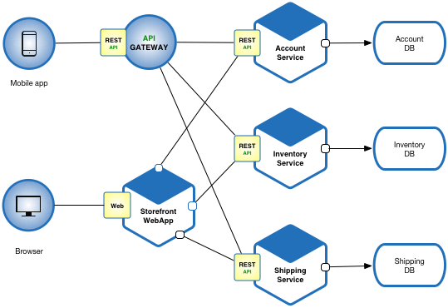
Application Database Design
owns
owns
Communication:
APIs or Event Streams (Kafka, RabbitMQ)
🔸 For example: ShippingService calls
AccountService to validate userId.
owns

Slide 30
Application Database Design
Online Shopping Portal
Database
G
A
T
E
W
A
Y
Product Management
Database
Order Management
Database
Account Management
Database
Payment Management
Login Management
Database

Slide 31
All services access this database directly
Integration Database Design
Online Shopping Portal
C
O
N
T
R
O
L
E
R
L
A
Y
E
R
D
A
O
L
A
Y
E
R
Product Management
Database
Account Management
Payment Management
Login Management
Order Management

Slide 32
Integration Database Design
Problems:
Tight coupling
Hard to Scale
Risky Schema Updates
Ownership ambiguity

Slide 33
Best Practice
Feature | Application DB | Integration DB
Coupling | Loose | Tight
Flexibility | High | Low
Service Ownership | Clear | Ambiguous
Scaling | Independent | Monolithic
Modern Architecture | Microservices | Legacy/Monolithic

Slide 34
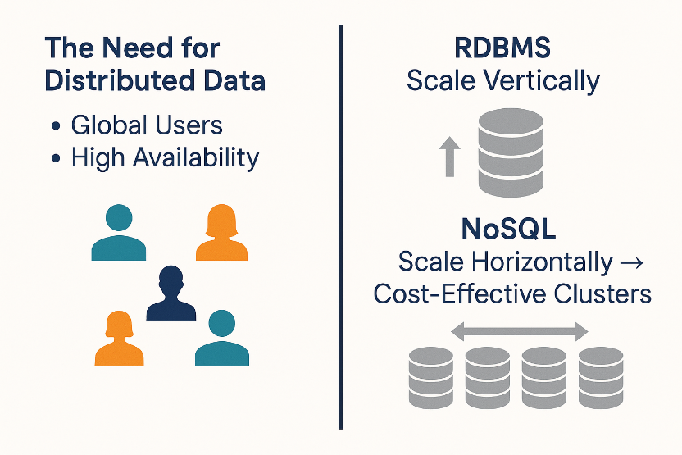
Attack of the Clusters
The need for distributed data:
1. Global Users
2. High Availability
RDBMS scale vertically -> cost & limits
NoSQL scale horizontally -> cost-effective clusters

Slide 35
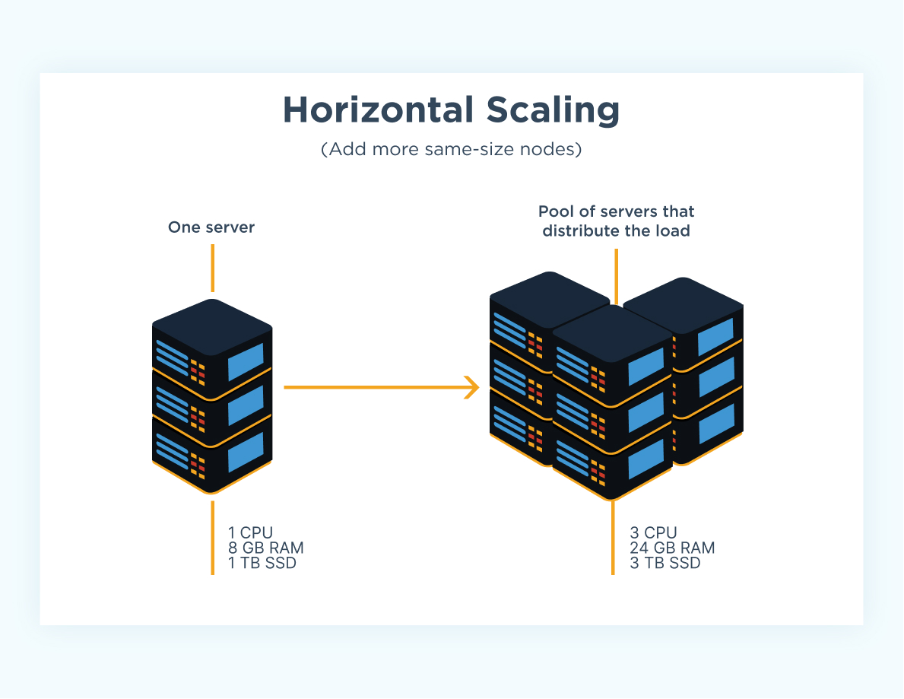
Attack of the Clusters

Slide 36
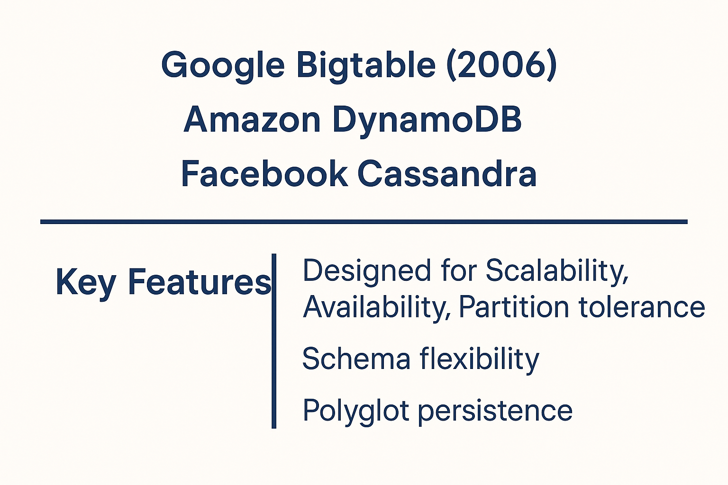
Emergence of NoSQL

Slide 37
Emergence of NoSQL
Emerged in the late 2000s, characteristically:
Non-relational
Schemaless
Cluster-optimized
Open source
Facilitates “polyglot persistence” using multiple data stores per application

Slide 38
Aggregate Data Models
A data model is the model through which we perceive and manipulate our data, It describes how user interacts with the data in the database.
A storage model whereas describes how the database stores and manipulates the data internally.
ER Model is a data model - relational. Refer examples.
NoSQL is a move away from the relational model.
Each NoSQL solution has a different model that it uses, which we put into four categories widely used in the NoSQL ecosystem: key value, document, column-family, and graph.
The first three share a common characteristic of their data models which we will call aggregate orientation

Slide 39
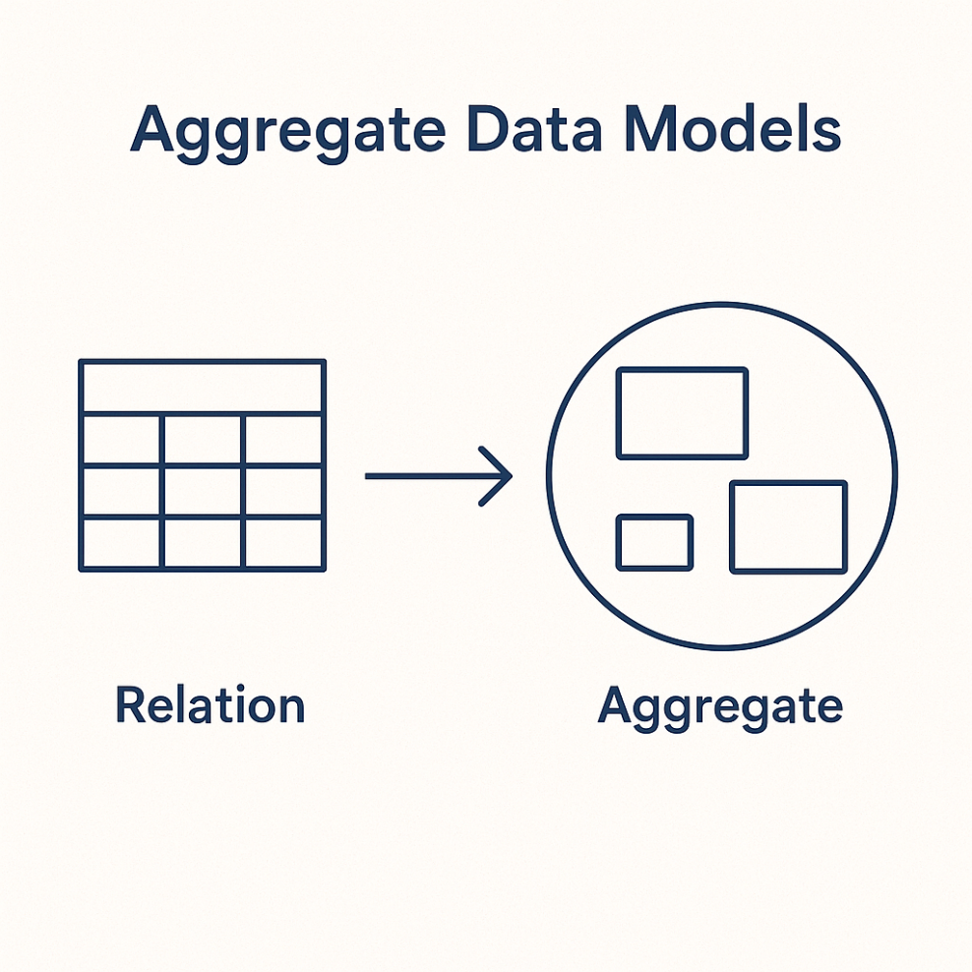
Aggregate Data Models
Aggregate: A collection of related objects treated as a unit (bounded context)
Simplifies Data distribution, Read/write operations
Basic for NoSQL design

Slide 40
Aggregates
Aggregates: A collection of related objects treated as a unit (bounded context)
Aggregate is a term that comes from Domain-Driven-Design.
an aggregate is a collection of related objects that we wish to treat as a unit. In particular it is a unit for data manipulation and management of consistency.
Follows atomic operation.
Dealing in aggregates makes it much easier for these databases to handle operating on a cluster, since the aggregate makes a natural unit for replication and sharding. Aggregates are also often easier for application programmers to work with, since they often manipulate data through aggregate structures.
Simplifies Data distribution, Read/write operations
Basic for NoSQL design

Slide 41
RDBMS (Normalized Data Model)
In relational databases, everything is split into multiple tables: Customer, Order, OrderItem, Address, Payment etc.
Data is connected using foreign key.
Advantages: no duplicate data, integrity maintained.
Drawback: You need joins across multiple tables to answer a simple query.
Example: To fetch a customer and their order details. Join 5-6 tables.

Slide 42
Aggregate Data Model (NoSQL)
In NoSQL, data is grouped into aggregates (self-contained units)
Example :
Customer aggregate -> contains list of billing addresses.
Order aggregate -> contains order items, shipping address, payments.
Advantages: Localized updates (only one aggregate updated).
Faster read/writes (no joins).
Drawback: Some data duplication (e.g. address repeated in different places).
Complex analytics harder (since no joins).

Slide 43
Embedded Model (Minimum aggregates)
Sometimes, instead of keeping customer and orders separate, we embed all orders inside the customer document.
This works best if :
You usually access customer + all orders together
If you usually access only single order -> better keep order as a separate aggregate.
So, aggregate boundaries depends on access pattern, called conext-specific, domain driven design.

Slide 44
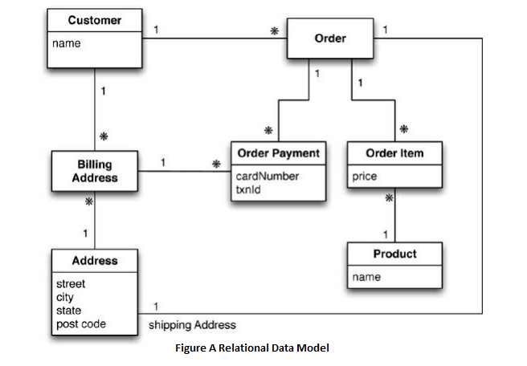
Example of Relations and Aggregates: e-commerce
A relational model of an e-commerce app.
we are going to be selling items directly to customers over the web, and we will have to store information about users, our product catalog, orders, shipping addresses, billing addresses, and payment data.

Slide 45
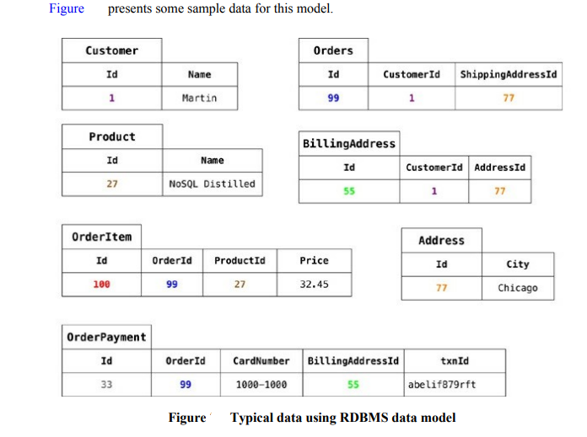
Example of Relations and Aggregates: e-commerce
Everything is properly normalized. No data is repeated in multiple tables. Connected by foreign key (maintaining integrities).
Note : A single logical address record appears three times in the example data.
we would ensure that the address rows aren’t updated for this case, making a new row instead.

Slide 46
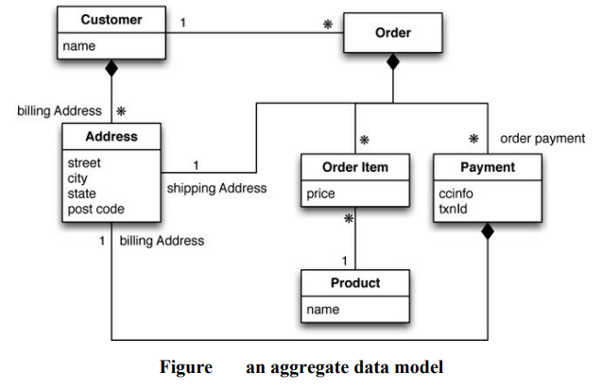
Example of Relations and Aggregates: e-commerce
An aggregate data model : In this model, we have aggregates: customer and order, Payment.
The customer contains a list of billing addresses; the order contains a list of order items, a shipping address, and payments. The payment itself contains a billing address for that payment.
With aggregates, we can copy the whole address structure into the aggregate as we need to.
Denormalization or minimize no. of aggregates is the goal. Next slide for minimum aggregates.

Slide 47
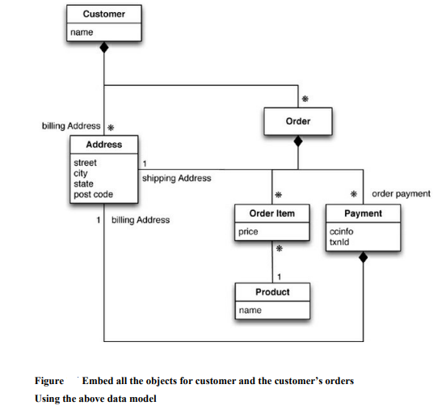
Example of Relations and Aggregates: e-commerce
Part of your thinking when developing the application data model
To set the aggregate boundaries.
Putting all the orders for a customer into the customer aggregate.
Aggregate orientation : In modeling, there’s no universal answer for how to draw your aggregate boundaries. It depends entirely on how you tend to manipulate your data. If you tend to access a customer together with all of that customer’s orders at once, then you would prefer a single aggregate. However, if you tend to focus on accessing a single order at a time, then you should prefer having separate aggregates for each order. Naturally, this is very context-specific

Slide 48
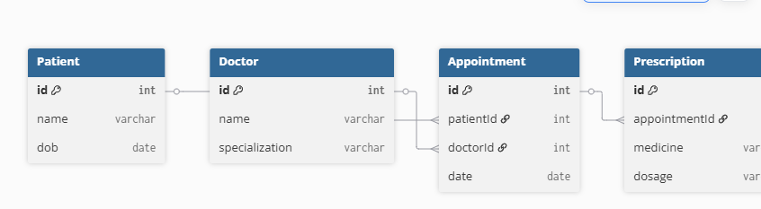
Example of Relations and Aggregates: Healthcare System
RDBMS Model (Normalized):
Patient (id, name, dob)
Doctor (id, name, specialization)
Appointment (id, patientId, doctorId, date)
Prescription (id, appointmentId, medicine, dosage)
Need multiple joins to get patient history with prescriptions.

Slide 49
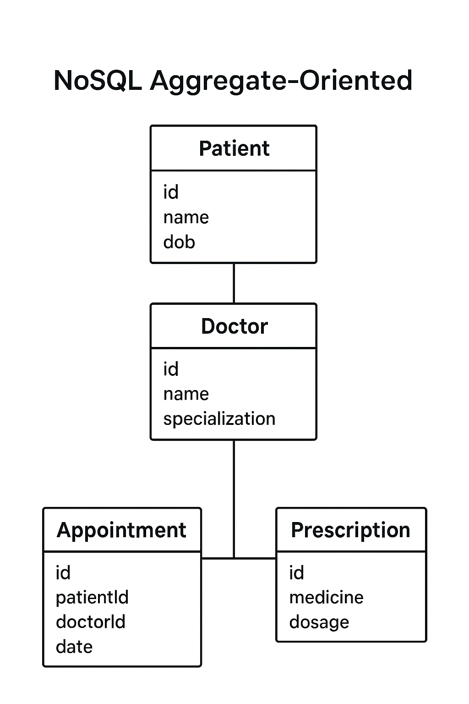
Aggregate-Oriented Model: Healthcare System
Patient Aggregate:
{
"id": 1,
"name": "John Doe",
"dob": "1990-01-15",
"appointments": [
{
"date": "2025-01-20",
"doctor": { "id": 10, "name": "Dr. Smith", "specialization": "Cardiology" },
"prescriptions": [
{ "medicine": "Aspirin", "dosage": "75mg" },
{ "medicine": "Metformin", "dosage": "500mg" }
]
}
]
}

Slide 50
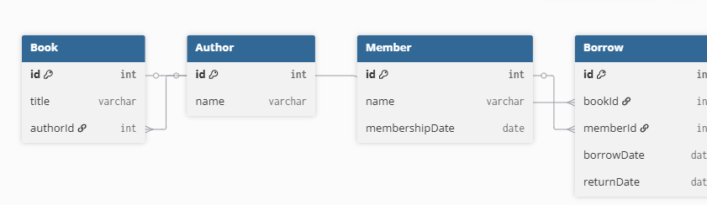
Example of Relations and Aggregates: Library Management System
RDBMS Model (Normalized):
Book (id, title, authorId)
Author (id, name)
Member (id, name, membershipDate)
Borrow (id, bookId, memberId, borrowDate, returnDate)
To get all books borrowed by a member, need joins across 3–4 tables..

Slide 51
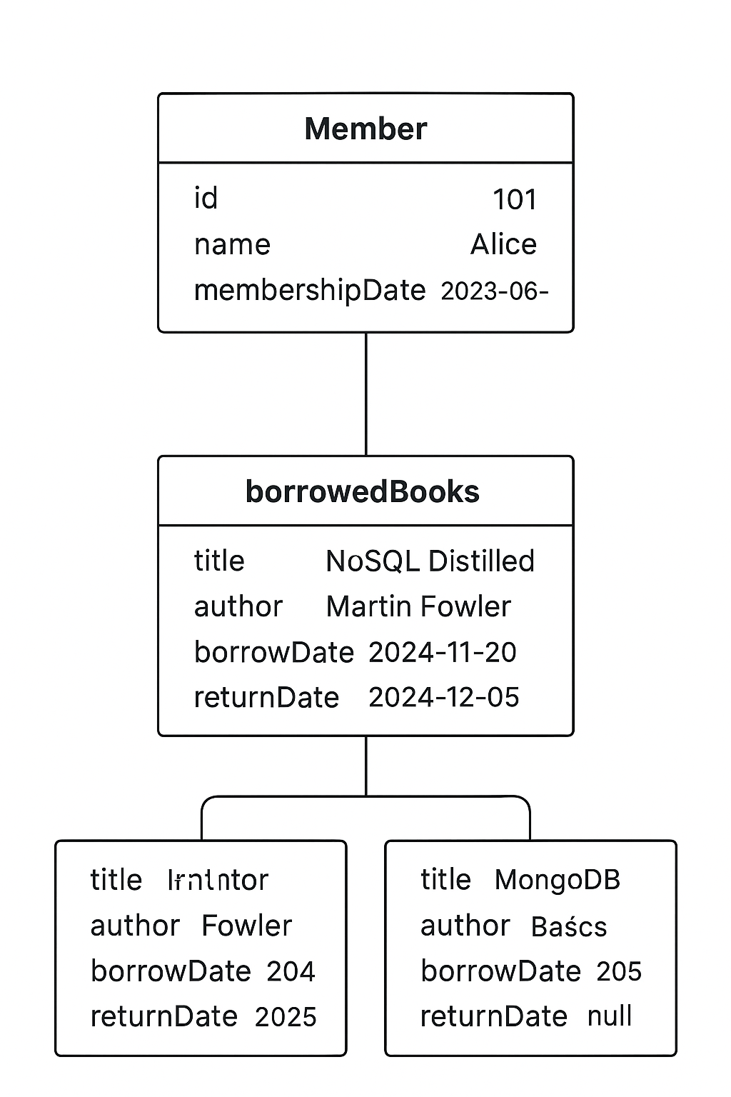
Aggregate-Oriented Model: Library Management System
Member Aggregate:
{
"id": 101,
"name": "Alice",
"membershipDate": "2023-06-15",
"borrowedBooks": [
{
"title": "NoSQL Distilled",
"author": "Martin Fowler",
"borrowDate": "2024-11-20",
"returnDate": "2024-12-05"
},
{
"title": "MongoDB Basics",
"author": "Kristina Chodorow",
"borrowDate": "2025-01-10",
"returnDate": null
}
]
}

Slide 52
Aggregate vs Relational : Summary
Relational Style : Separate tables for users and orders; relational joins are needed for combined views
Aggregate (Document) Style : A single document containing user data along with embedded order list. This allows retrieval in one request and simplifies programming model.
Trade-offs:
Pros : Data locality, simple distributed updates, aligned with
application aggregates.
Cons : Duplication, eventual consistency concerns, complexity in
cross-aggregate analytics tasks.

Slide 53
Example : Relations vs Aggregates : Summary
Relational : User table, Orders table -> Join required
Aggregate (Document):
{
"user_id": "123",
"name": "Sunil",
"orders": [
{ "order_id": 1, "item": "Book" },
{ "order_id": 2, "item": "Pen" }
]
}

Slide 54
Consequences of Aggregate Orientation
Pros:
Localized updates
Simplified scaling
Better performance in read/writes
Cons:
Data duplication
Harder analytics & Joins

Slide 55
Consequences of Aggregate Orientation
Pros:
Localized updates :
Each aggregate is stored as a single unit (JSON document in MongoDB)
Updating one customer’s order does not affect other documents.
No need for complex joins or transactions across multiple tasks.
{
"orderId": 1001,
"customer": "John Doe",
"items": [
{ "product": "Laptop", "qty": 1, "price": 800 },
{ "product": "Mouse", "qty": 2, "price": 20 } Updating order status=just update
], one document
"status": "Shipped"
}

Slide 56
Consequences of Aggregate Orientation
Pros:
Localized updates
Simplified scaling :
Aggregates can be sharded across different servers.
Each aggregate is independent → easy distribution across nodes.
Improves horizontal scaling.
Better performance in read/writes
Reads: Most queries can fetch a whole document in one lookup.
Writes: Adding a new order/customer/product means one insert operation, not multiple inserts across multiple tables.

Slide 57
Consequences of Aggregate Orientation
Cons:
Data duplication
Since data is stored inside aggregates, shared info may repeat.
Example: Customer address stored in every order document → updates require changing multiple documents.
Harder analytics & Joins
Aggregates don’t support joins easily (unlike relational DBs).
2. Cross-aggregate queries (e.g., “Total sales by city”) require either:
Application-side joins, or
Special indexing/aggregation pipelines.

Slide 58
Types of Aggregate – Oriented Databases
Key-value Stores:
Simple, fast lookups (Redis, DynamoDB)
Document Stores:
Semi-structured JSON/ XML (MongoDB, Couchbase)
Column-Family Stores:
Wide-column layout (Cassandra, HBase)

Slide 59
Key-Value and Document Data Models
key-value and document databases were strongly aggregate oriented.
These databases as primarily constructed through aggregates.
Both of these types of databases consist of lots of aggregates with each aggregate having a key or ID that’s used to get at the data.
The aggregate is opaque to the database just some blob or bits.
A document database imposes limits imposing allowable size, structures and types on aggregates.
Some stores aggregates as JSON or XML structures.
With a document database, we can submit queries to the database based on the fields in the aggregate, we can retrieve part of the aggregate rather than the whole thing, and database can create indexes based on the contents of the aggregate.
With a key-value store, we can only access an aggregate by lookup based on its key.
Redis allows you to break down the aggregate into lists or sets.

Slide 60
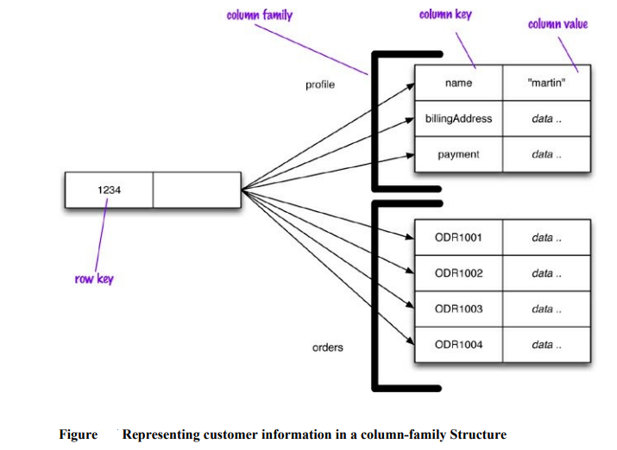
Column-Family Stores
A tabular structure which it realized with sparse columns and no schema.
HBase and Cassandra.
it is a two-level map.
Hence it is as a two level aggregate structure.
The first level key as a row identifier.
This row aggregate is itself formed of a map of more detailed values.
The second-level values are referred to as columns.

Slide 61
Column-Family Stores
RowKey → { ColumnFamily: { ColumnName : Value } }
Example Rowkey = user123
Firstmap = Rowkey (user123)
Secondmap = Column-families (profile, Order) "user123": {
"Profile": {
"name": "Alice",
"email": "alice@email.com"
},
"Orders": {
"order1": "Laptop",
"order2": "Mouse"
}
}
Each row (with its row key) acts like an aggregate root.
All related data about that entity (user, order, etc.) is stored together under that row, spread across column families.
When you read or update, you usually work with the whole row (aggregate) instead of doing joins like in RDBMS.
So the aggregate = row with column families.

Slide 62
Summary : Aggregate-Oriented Databases
Type | Example | Use Case
Key-Value | Redis | Caching, session management
Document Store | MongoDB | Content, catalogs, users
Column-Family | Cassandra | Logging, metrics, time-series

Slide 63
Beyond Aggregates: Other Data Models
Graph Databases (Neo4j): Complex relationships
Schema-less Databases: Flexible, dynamic schema
Materialized Views: Precomputed views for speed
Data Modeling for Access: Design around queries, not normalization

Slide 64
Schemaless Databases
NoSQL databases are schemaless.
When you want to store data in a relational database, you first have to define a schema—a defined structure for the database which says what tables exist, which columns exist, and what data types each column can hold. Before you store some data, you have to have the schema defined for it.
With NoSQL databases, storing data is much more casual. A key-value store allows you to store any data you like under a key. A document database effectively does the same thing, since it makes no restrictions on the structure of the documents you store. Column-family databases allow you to store any data under any column you like. Graph databases allow you to freely add new edges and freely add properties to nodes and edges as you wish.

Slide 65
View, Materialized View
In Connection with Aggregate data models.
The Problem with Aggregates
In an aggregate oriented NoSQL model, data is grouped ( like an order document containing all items)
But if you want a summary across many aggregates, e.g:
“How many iPhones sold in the last 2 weeks?
You may have to scan every order document.
Which is slow.

Slide 66
View, Materialized View
CREATE VIEW total_sales AS
SELECT productId, SUM(quantity) as totalSold
FROM Orders
GROUP BY productId;
When you query the view, the database runs this query on the fly.
Problem: If the dataset is huge, recalculating every time = slow.

Slide 67
View, Materialized View
Materialized View
A materialized view = precomputed + cached results of the view.
Stored on disk like a real table.
Database updates it periodically or when data changes.
So queries are much faster, though the data may be slightly stale.

Slide 68
Materialized View
In Connection with Aggregate data models.
It is SQL (relational) feature, helps to reduce the slow performance in fetching an aggregates.
Example : if a product manager wants to know how much a particular item has sold over the last couple of weeks? Now the aggregate-orientation works against you, forcing you to potentially read every order in the database to answer the question.
A view is like a relational table (it is a relation) but it’s defined by computation over the base tables. When you access a view, the database computes the data in the view—a handy form of encapsulation.
Views provide a mechanism to hide from the client whether data is derived data or base data—but can’t avoid the fact that some views are expensive to compute.
To cope with this, materialized views were invented, which are views that are computed in advance and cached on disk.
Views + Caching is Materialized View.
Materialized views are effective for data that is read heavily but can stand being somewhat stale.
NoSQL supports Materialized view.

Slide 69
Materialized View
Let’s say you want “Total sales per product”.
Without materialized view:
Query = scan millions of orders, calculate sum, return result. → slow
With materialized view:
Database already keeps a ready-made table of totals.
Query just fetches from that cached table. → fast

Slide 70
NoSQL Data Modeling Principles
Understand access patterns first
Denormalize for performance
Choose DB type based on use case
Embrace eventual consistency if needed

Slide 71
Data Models Overview
Key-Value Stores : Simplest aggregate form. Very fast lookups by key; minimal querying capabilities.
Document Stores : Aggregates represented as JSON/BSON documents; flexible schema, indexing possible.
Column-Family Stores : Aggregates organized in column families; excellent for time-series, wide sprase data.
Graph Databases : Support strong relationships across aggregates. Abstracts entities and relationships naturally; not aggregate-oriented.
Schema-less Databases : Support flexible data models that evolve with application needs, avoiding rigid schema migrations typical in RDBMS.
Materialized Views & Modeling for Access : Used to optimize queries that cross aggregates via mechanisms like map-reduce or secondary indexing. Design is driven by query patterns rather than normalized modeling.

Slide 72
Conclusion
NoSQL emerged due to RDBMS limitations in modern apps
Aggregate models fit naturally into distributed systems
Variety of NoSQL types for different needs
Choose the right model for the right job

Slide 73
Question Bank
SL.No | Questions | LOs
1 | Define NoSQL Database and List the different types of NoSQL Database. | LO1
2 | Explain Key-Value pair Database. | LO1
3 | Explain Column-oriented databases. | LO1
4 | Explain Document-Oriented database. | LO1
5 | Explain Graph Based Database. | LO1
6 | Explain Concurrency and integration with an example. | LO3
7 | Explain ACID Properties with an example. | LO2
8 | Describe the history of NoSQL. | LO4
9 | List the feature of NoSQL. | LO4

Slide 74


